Slide 1
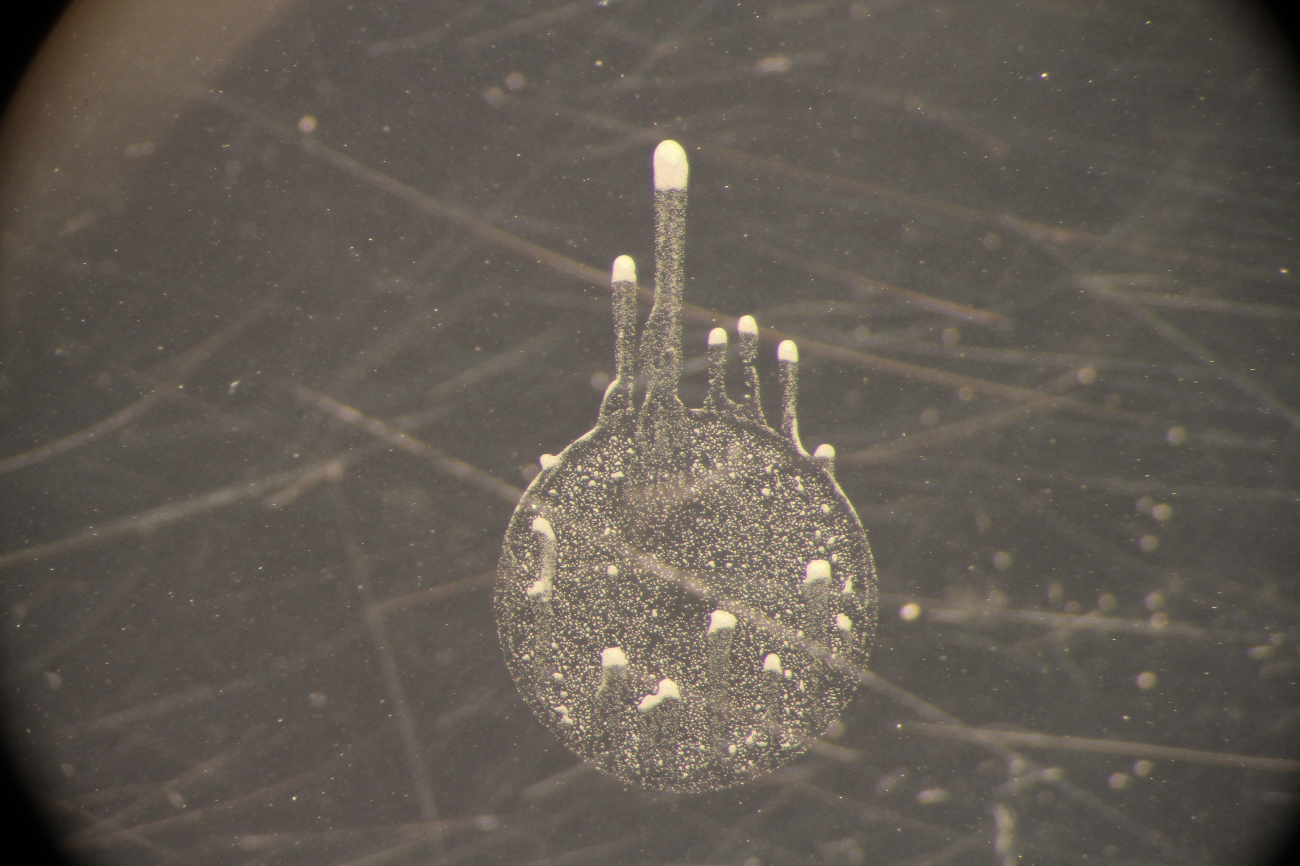
Cells used from (Directed light repeat 2) plate, started on 14 Dec. The region that the microscopy was focused on is bordered in yellow. Finger-crashing experiment was commenced 58 hrs after the start of the 14-Dec experiment
Original direction of white LED
New direction of white LED

Slide 2
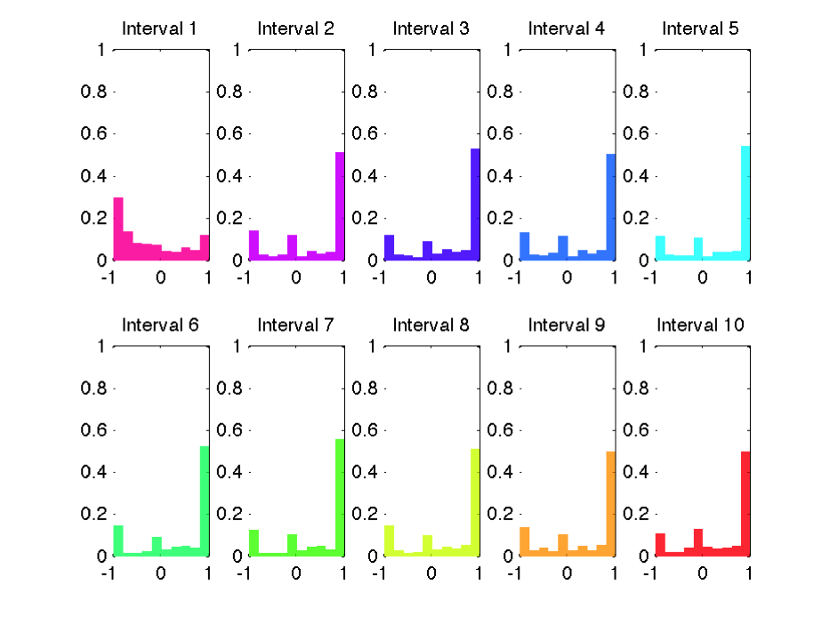
finger_crashing_17dec2011 Evolution of cells’ bias toward new light direction each interval is over the span of 10 frames (6sec/frame)

Slide 3
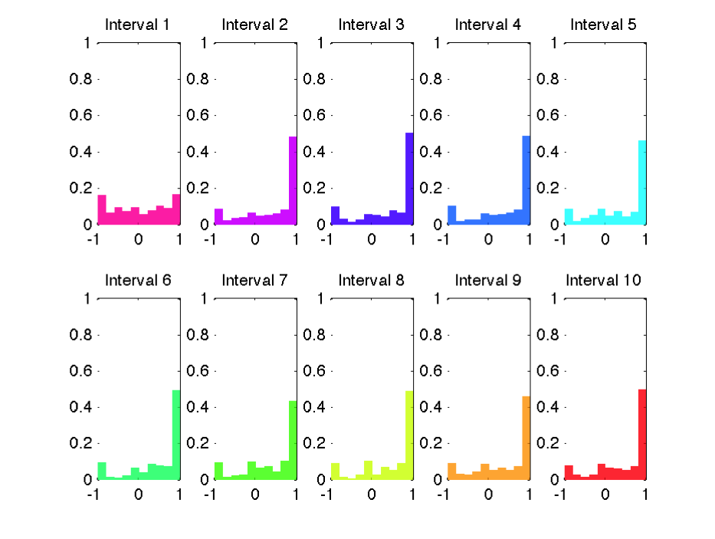
Evolution of cells’ bias toward new light direction each interval is over the span of 20 frames (6sec/frame) Trend is the same as a 10-frame interval

Slide 4
Why did I get the bimodal histogram? (when other experiments didn’t have one)
With other experiments I got Gaussian-like plots like this:

Slide 5
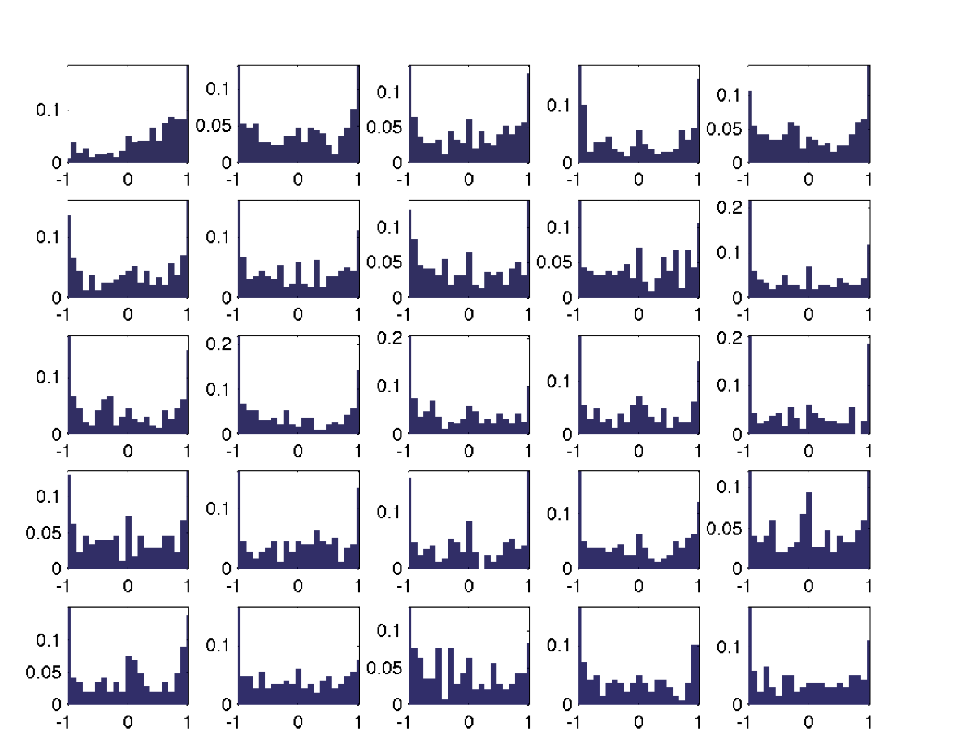
It depends on the interval over which you calculate the bias! The following plots are along the x-axis (old light direction)
60-sec interval
Tracks shown in next slide

Slide 6
Tracks for the 6th interval
Cells are mostly either moving right or left, if you only look along the horizontal axis
Look along this axis

Slide 7
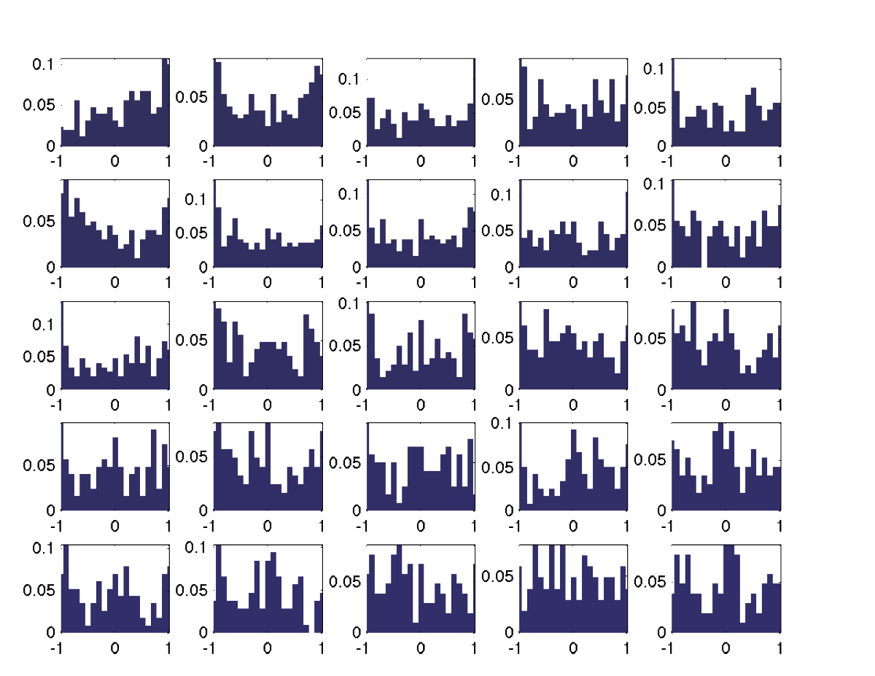
Using 120-sec intervals still does not remove the bimodal distribution
Tracks shown in next slide

Slide 8
Cells are still mostly either moving right or left

Slide 10
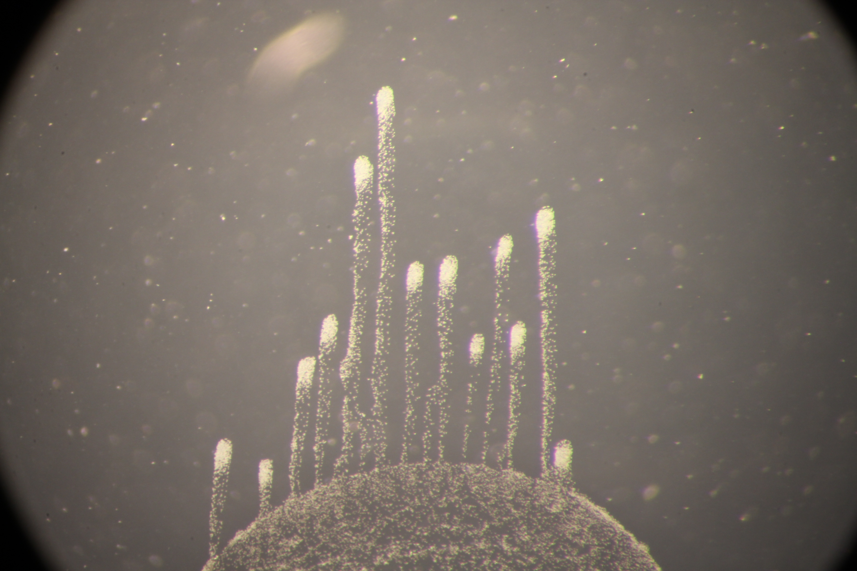
20 Aug experiment (thinner fingers)

Slide 11
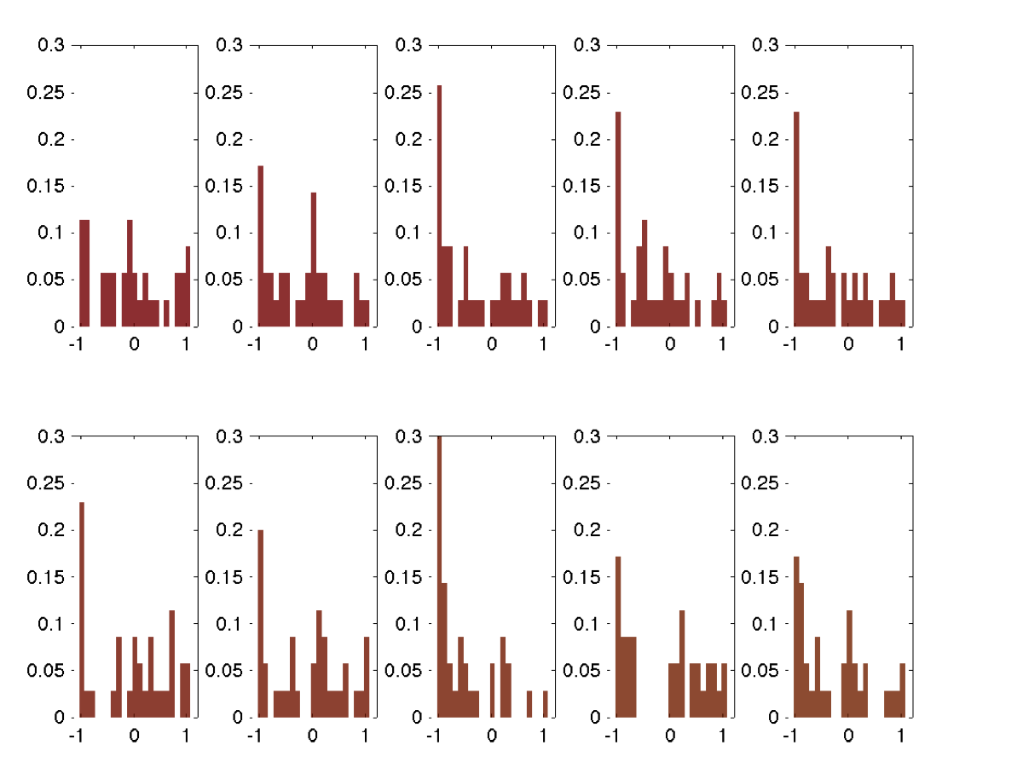
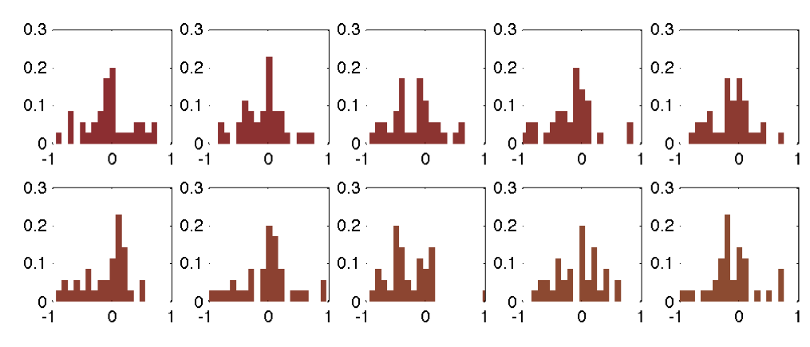
Comparing to a later experiment (20Aug), in the same midfinger region I am going to compare the results between tracking cells every sec versus every 6 sec (as in the previous experiment)
Along old light direction (showing first 10 intervals here)
Cells tracked every second, with bias values taken over 60-sec intervals
Cells tracked every 6 seconds, with bias values taken over 60-sec intervals

Slide 12
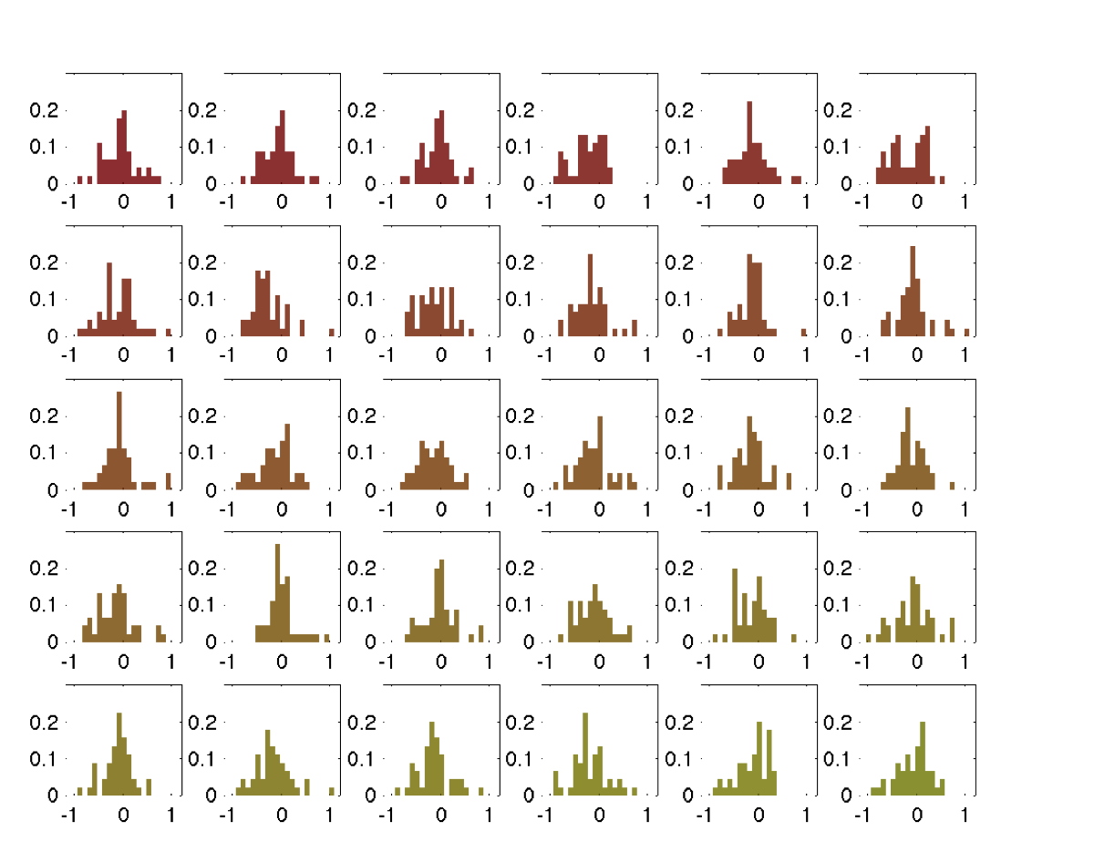
Showing all the intervals here..
Cells tracked every second, with bias values taken over 60-sec intervals

Slide 13
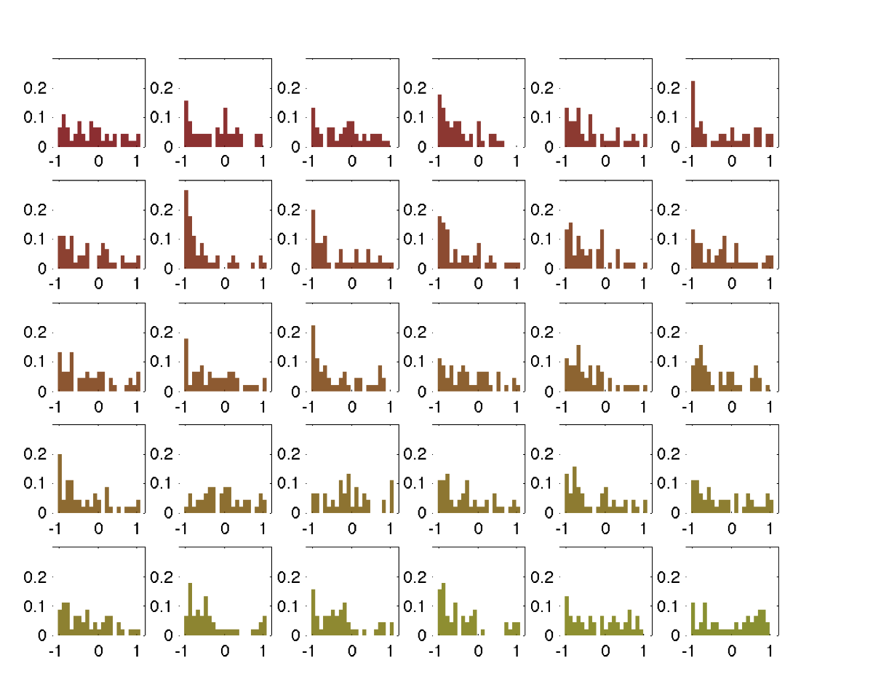
Cells tracked every 6 seconds, with bias values taken over 60-sec intervals

Slide 14
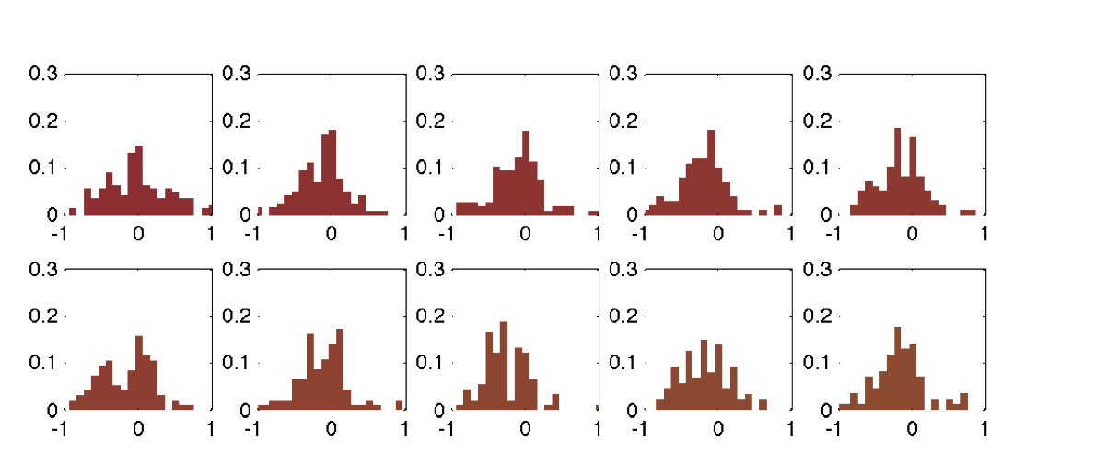
Bias in the direction along the old light axis

Slide 15
Tracks of cells taken from the 6th interval
Cells tracked every 6 seconds, with bias values taken over 60-sec intervals
These tracks are from 313th to 361st seconds
Cells tracked every second, with bias values taken over 60-sec intervals
These tracks are from 302th to 361st seconds
You can see that the tracks are slightly different (more deviations from a ‘straight’ path in the left photo), which can explain why the absolute bias values are smaller.
I am not sure why the bimodal distribution is more pronounced in the 14 Dec experiment, though the 14Dec finger was much thicker than the 20Aug finger, so perhaps that might be the reason? I will need to take more data with different sizes of fingers to probe that.

Slide 16
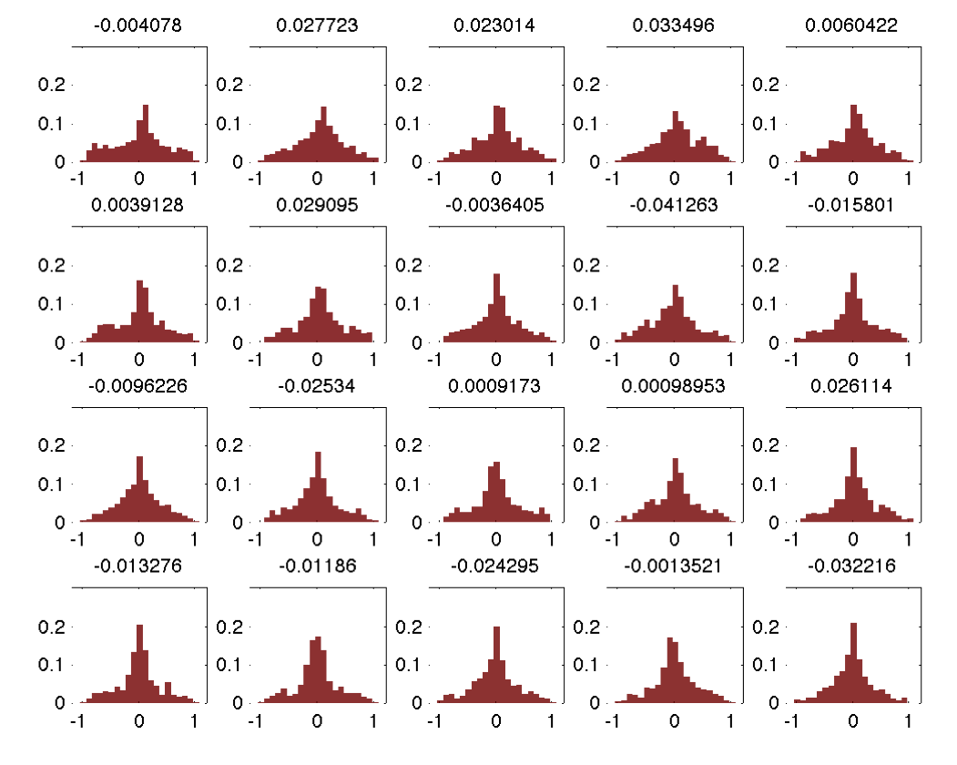
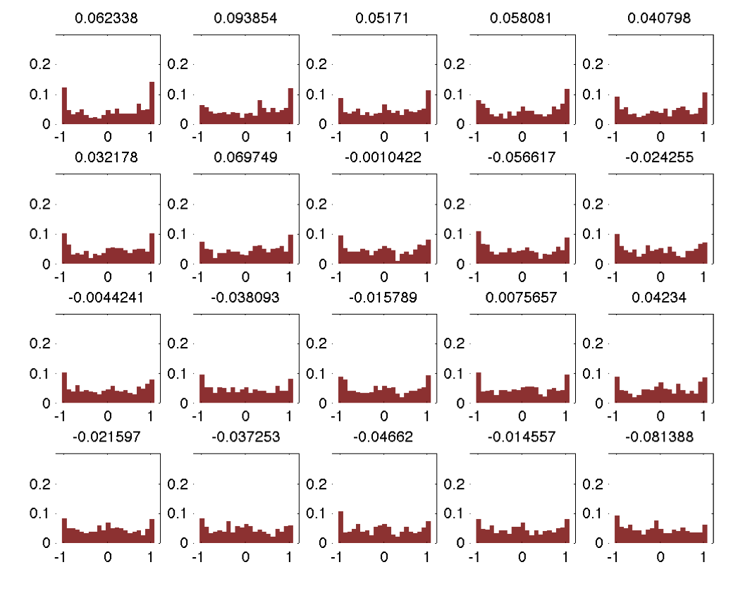
Got the same result from another repeat experiment (18March2013)..
Cells tracked every second, with bias values taken over 60-sec intervals
Cells tracked every 6 seconds, with bias values taken over 60-sec intervals

Slide 18
It looks like having greater time resolution really changes the result in bias distribution. I suppose we care

Slide 19
Changing the standard deviation of defined bias values in simulations
For mean defined bias = 0.15
For mean defined bias = 0.5
Allowing for a range of defined bias values cause the cells to occasionally move backward, an effect more pronounced at higher defined standard deviations

Slide 20
Mean defined bias= 0.5, std dev=0.8 Surprisingly, the mean bias is lower in the finger region than in the drop (taken at 110th timepoint, out of 200 timepoints),
Mean = 0.8167
Mean = 0.7048

Slide 21
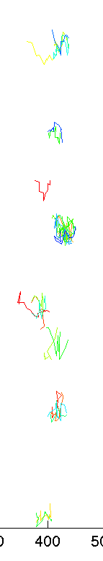
So the cells in the finger are not just moving progressively forward?
Here’s a subset of cell tracks moving in the finger
Incident light

Slide 22
Mean defined bias = 0.15, std dev = 0.3 The cells at the front of the drop have a distinctly higher movement bias, which is different from experiments, where the finger region have a higher bias.. Tip>midfinger

