Slide 1


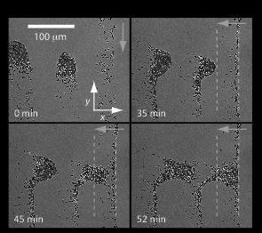
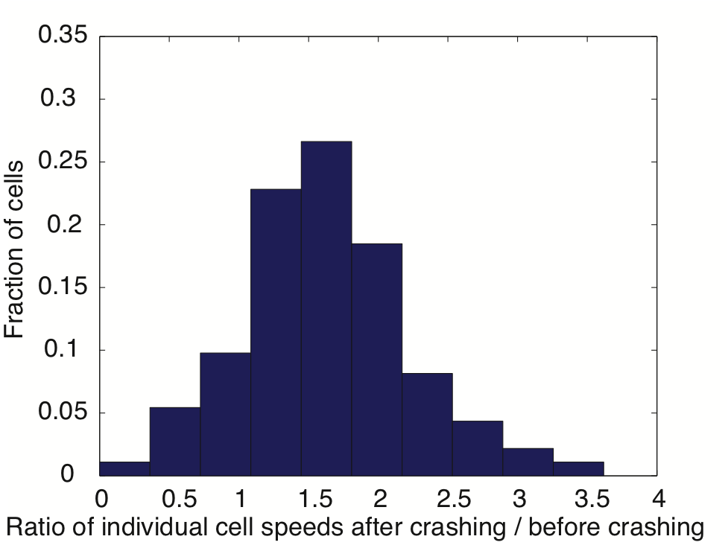
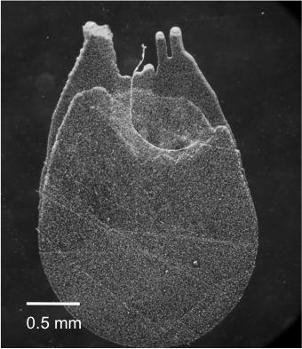
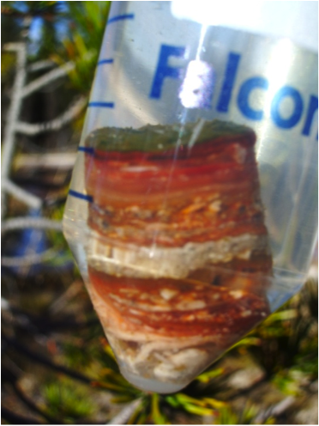
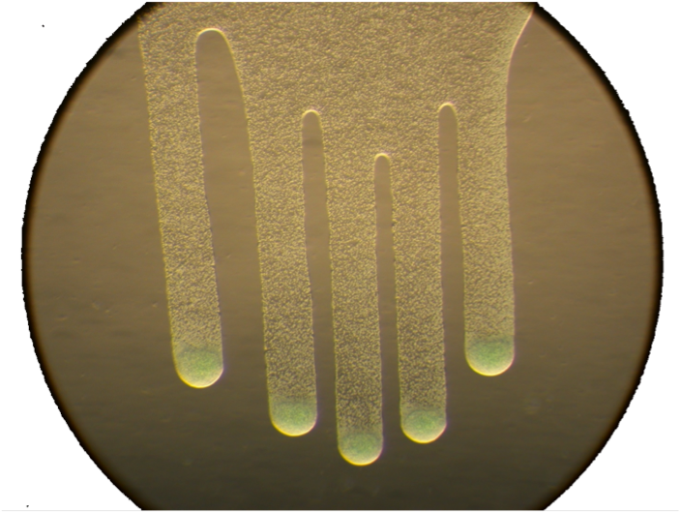
Motility Enhancement through Surface Modification is Sufficient for Emergent Behaviors during Phototaxis
Rosanna Chau¹, Devaki Bhaya², Kerwyn Casey Huang¹
¹Department of Bioengineering, Stanford University ²Department of Plant Biology, Carnegie Institution of Washington
Introduction
The emergent behaviors of communities of genotypically identical cells cannot be easily predicted from behaviors of individual cells. In the cyanobacterium Synechocystis, phototactic behavior occurs on both the single-cell and community levels. While single cells undergo a biased random walk, dynamic finger-like subcommunities also form toward the light. We show that extracellular polymeric substances (EPS) play a major role in motility enhancement and community formation.
Light
1 mm
Figure 1. On a 2-dimensional surface, an inoculation of cells produces finger-like projections toward a directed light source. Single cells (see insert) exhibit biased random walk (motion over 200 seconds is shown).
EPS enhances single cell motility
Upon encountering a region of high [EPS] (an adjacent finger), single cell velocities increased ~three-fold.
The presence of EPS enhances the movement bias of single cells toward light
Cells have a more pronounced movement bias toward light in the regions with expectedly more secreted EPS.
A
B
Figure 2. (A) The light direction incident (orange arrow) on finger-like projections was rotated 90º to induce the movement of cells (35 min after light change) into the area spanned by an adjacent finger (white dashed lines). (B) Cells are observed to move faster in the new region of high EPS concentration (relative to the agarose substrate), with velocities enhanced by 3.3x on average.
A
Light
B
C
EPS does not confer information about directionality
Upon a change in the light condition, cells rapidly change their motility behavior, with no persistence to their previous behavior.
Figure 3. (A) (Example cell track shown) The movement bias of a cell is taken over a 100-second interval, where bias = (displacement toward light) / pathlength. (B) Quantification of the movement bias of single cells in different regions of a fingered inoculation showed (C) higher bias toward light in regions where more EPS can be expected to be secreted onto the surface (center, front,and midfinger regions). The mean bias value is included in parentheses within the legend.
A
Light
B
C
Light
Light
Indirect, surface-based communication is sufficient to produce phototactic subcommunities
We have developed a simple cellular automata model that assumes a biased random walk dependent solely on light direction and local EPS concentrations.
Our model successfully reproduces the phenotype of distinct motile groups whose shape match experimental observations.
1 mm
Light
y
x
y
x
D
A
B
Bias due to light source
C
Light
cell
Time
EPS
Grid with some concentration of EPS
Figure 4. (A) Within less than 5 min after a change in the incident light direction, cells quickly recovered the corresponding bias distribution (subfigure B) along the respective axes. (C) Similar behavior was observed, with the light source switched off and then back on. Cells rapidly lost their bias toward the original light direction upon darkness, and regained the same bias upon re-illumination. This demonstrates that the cells have no memory of past light states, and the existing EPS confers no directionality to movement.
Cell at arbitrary location
Figure 5. (A) Schematic of cellular automata model. Each cell (green) secretes EPS (grey halo) over time and moves with a probability distribution that is (B) dependent on the local EPS concentration and biased toward the direction of the light source. (C) Our model reproduces the finger-like projections extending toward the light source.
Conclusions and Future Work
The indirect, surface-based communication via EPS is sufficient, excluding direct cellular interactions or changes in single-cell behavior, for the emergence of complex community behavior. Such forms of surface-based communication can provide insight into the behavior of a wide array of biological communities.
This work is funded by NSF/NIGMS #0758374, The Carnegie Institution of Science, the National Academies Keck Future Initiatives seed grant program, and the Stanford University Bio-X Interdisciplinary Initiatives Program.

