Slide 1
The Response of Bacterial Growth to
Osmotic Shock
Rico Rojas
Theriot and Huang Labs
Simbios Center for Biomedical Computation

Slide 2
Outline
Background and motivation for measuring the growth-rate response to osmotic shock.
The case of E. coli.
Review of old data: hyperosmotic shocks.
New data: Hypoosmotic shocks and MreB motion during osmotic shocks.
Brief comparison to the experimental results from B. subtilis.
Chalk talk: simple theory comparing the mechanics of Gram-negative and Gram-positive bacteria.
Preliminary results from V. cholera and P. aeruginosa.
Mini-presentation by Alex Cobb.

Slide 3
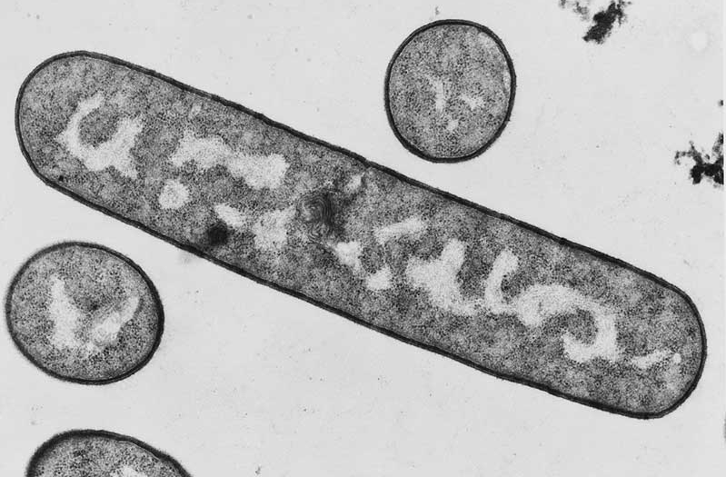
Background: osmotic pressure and the cell wall.
B. subtilis

Slide 4
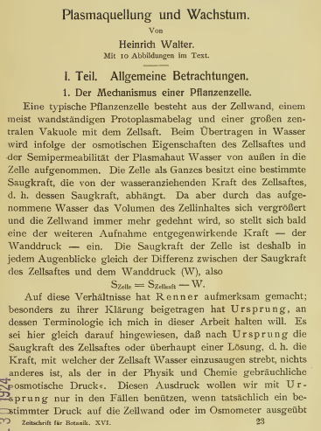
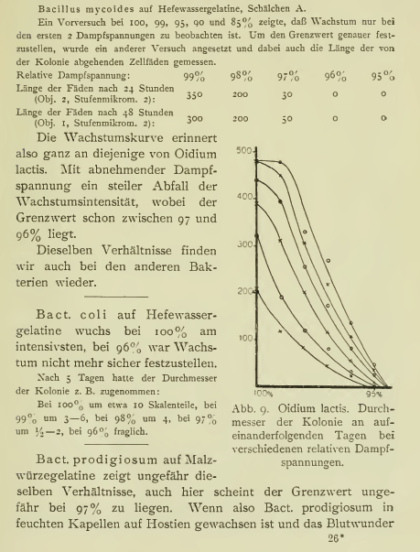
History of the idea that osmotic pressure drives cell growth

Slide 5
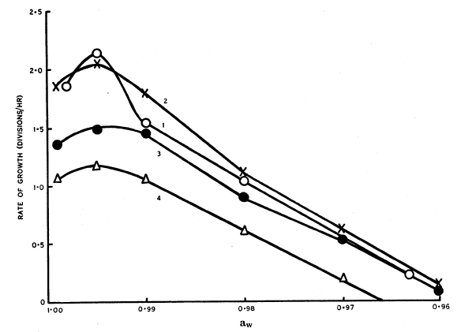
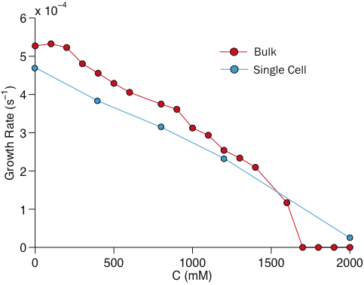
History: Growth rate and medium osmolarity are negatively correlated
Christian, 1955

Slide 6
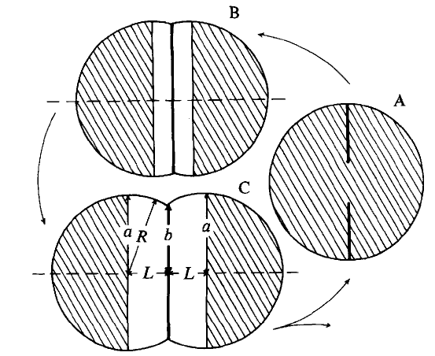
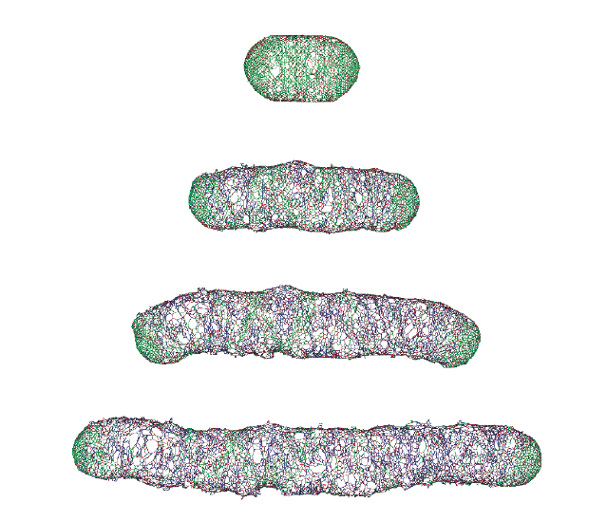
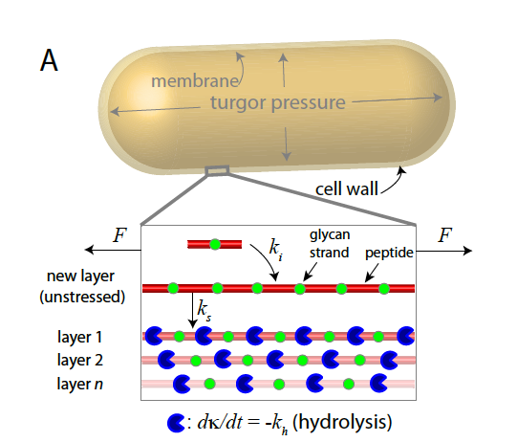
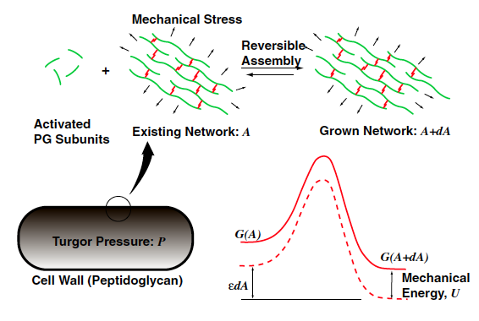
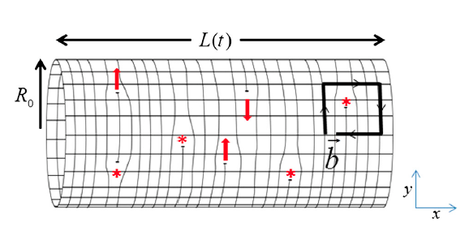
History: Theories of pressure driven bacterial growth.
Koch, 1980s
Furchtgott, 2011
Misra, 2013
Amir 2012
Jiang, 2010

Slide 7
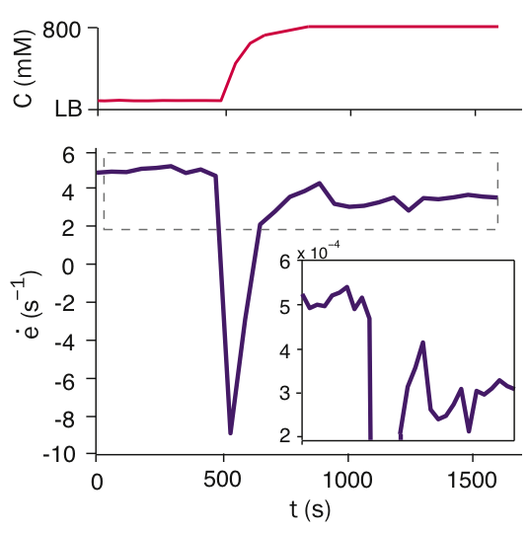
Do acute osmotic downshocks reduce elongation rate?

Slide 8
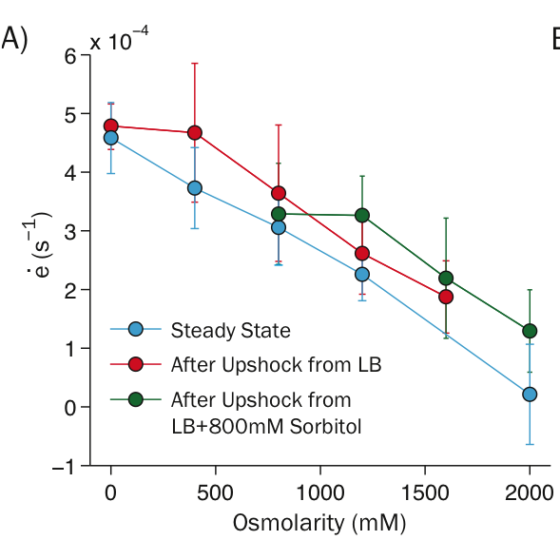
E. coli grows faster after upshock than it does at steady-state?

Slide 9
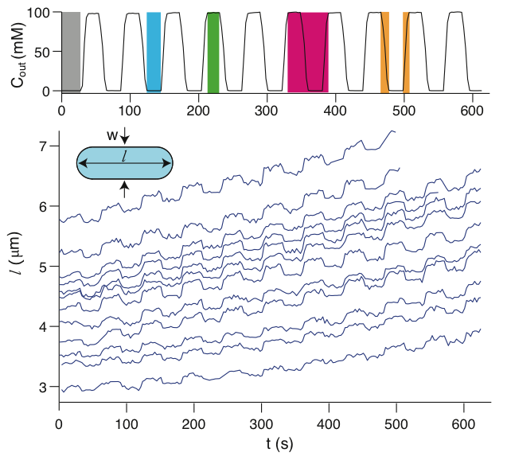
Do acute osmotic downshocks reduce elongation rate?

Slide 10
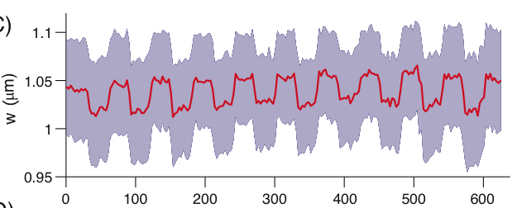
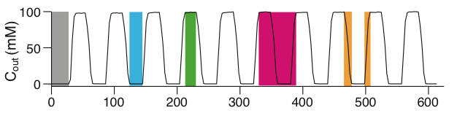
Cell width gives us an indirect measurement of osmotic pressure?

Slide 11
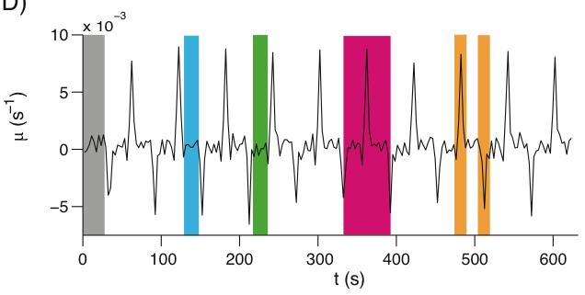
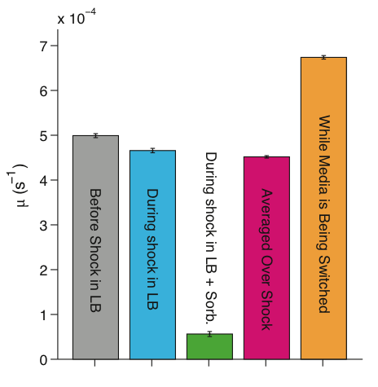
Hyperosmotic shock reduces growth rate at short time scales, but growth is “stored.”

Slide 12
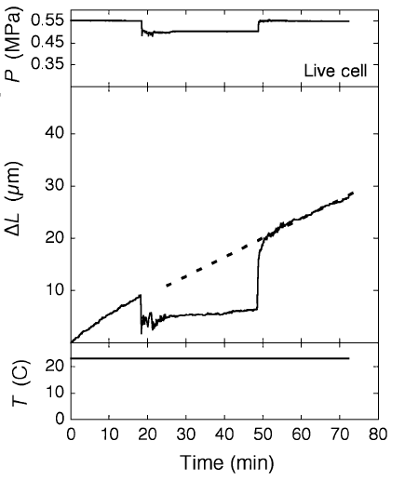
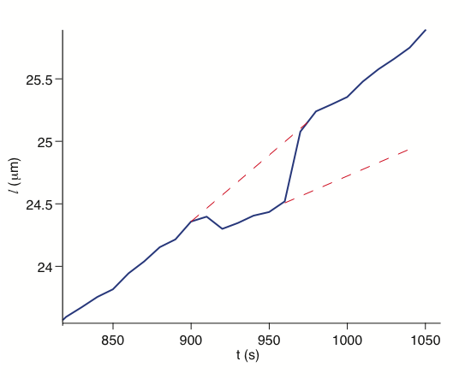
A brief history of “stored growth.”
Proseus, 2008

Slide 13
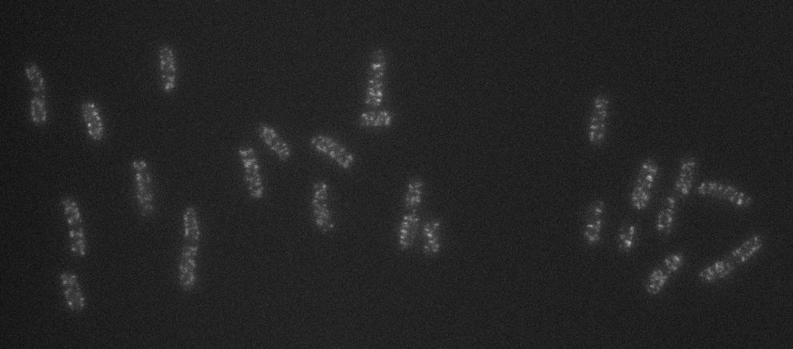
Does MreB velocity depend on osmotic pressure?

Slide 14
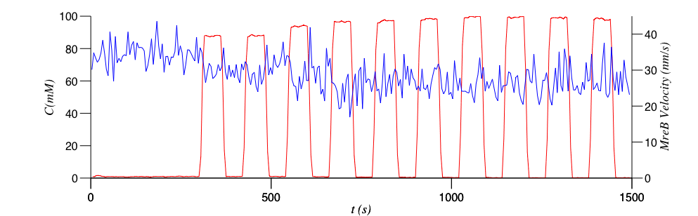
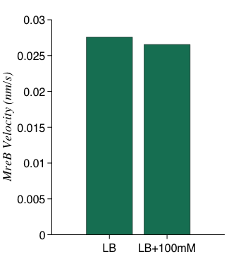
Does MreB velocity depend on osmotic pressure?

Slide 15
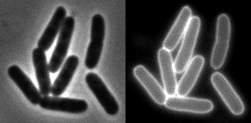
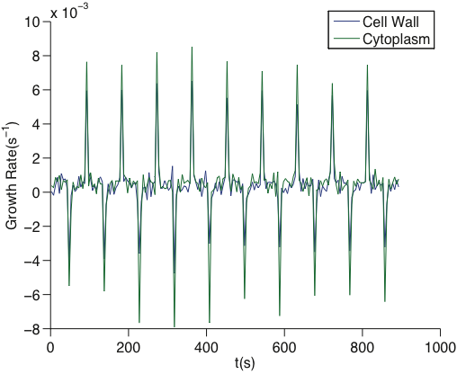
Comparing phase tracking to cell wall tracking.

Slide 16
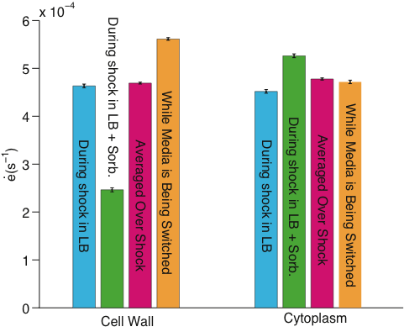
Comparing phase tracking to cell wall tracking.

Slide 17
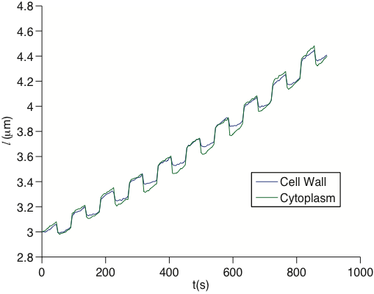
Decreased growth may be due to slight plasmolysis.

Slide 18
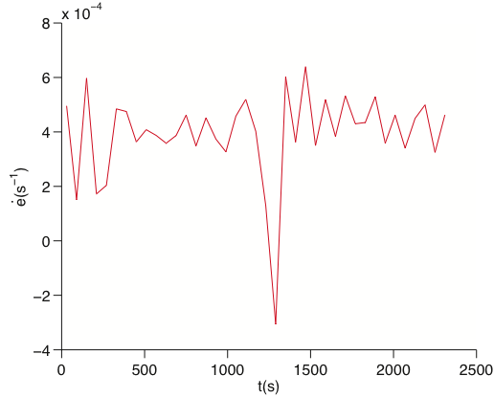
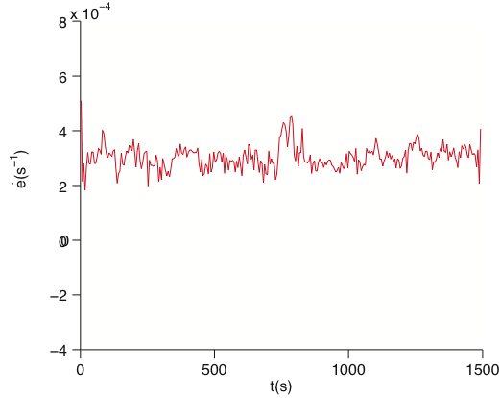
Cells do not stretch significantly in response to hypoosmotic shock.
400mM Upshock
400mM Downshock

Slide 19
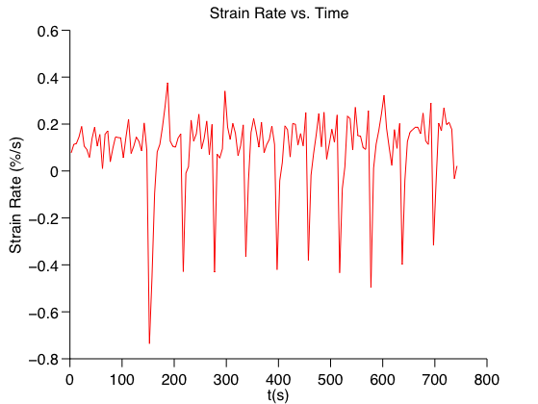
V. cholera never stretches upon downshock.
E. coli
V. cholerae

Slide 20
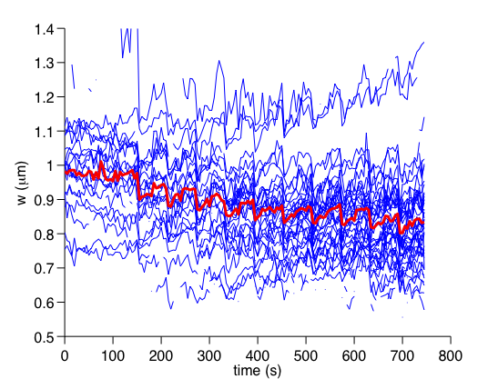
The width reveals that osmotic pressure may be ratcheting down.

Slide 21
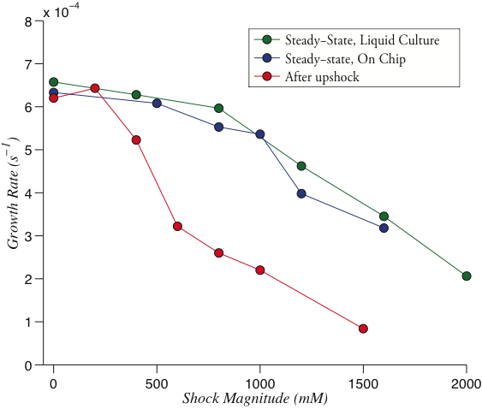
B. subtilis grows slower after upshock than it does at steady state.

Slide 22
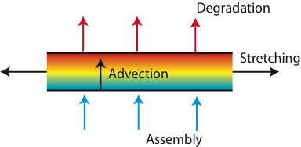
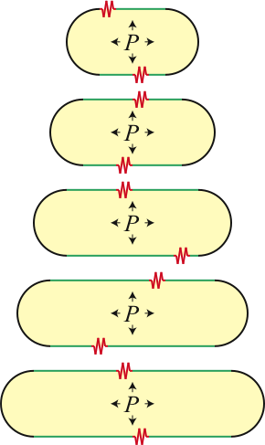
Consequences of wall thickness for growth strategy.
E. coli
B. subtilis

Slide 23

Thank you!

