Slide 1
The Response of Bacterial Growth to
Osmotic Shock
Rico Rojas
Theriot and Huang Labs
Simbios Center for Biomedical Computation
Biochemistry Retreat, 2012

Slide 2
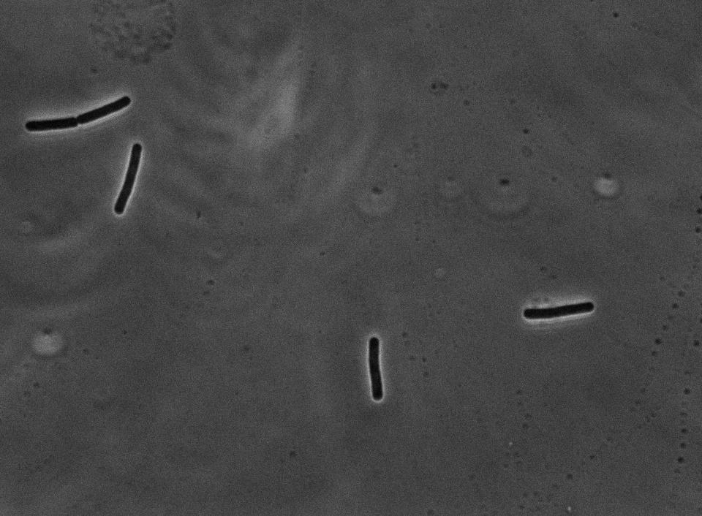
How do bacterial cells grow:
What are the mechanical forces that drive growth?
How do bacterial cells grow:
What are the mechanical forces that drive growth?
How are these forces controlled at the chemical level?
How do bacterial cells grow:
What are the mechanical forces that drive growth?
How are these forces controlled at the chemical level?
Can we use mechanical perturbations to probe this chemistry?

Slide 3
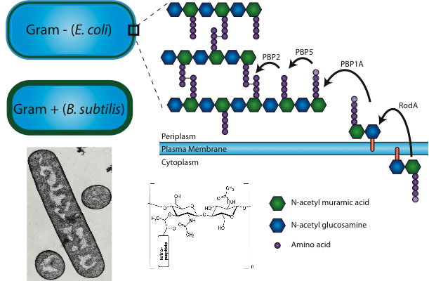
Bacteria cells are enclosed by a cell wall, a cross-linked polymer network.

Slide 4
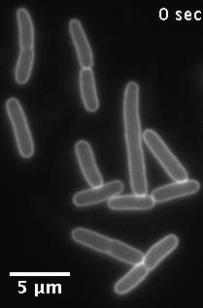
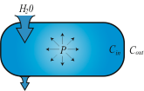
The cell wall bears considerable load due to high internal osmotic pressure.
Gram negatives: P≈1 atm
Gram positives: P≈10 atm
E. coli, wall stained with WGA
Does cell wall expansion, and therefore cell growth, depend on osmotic pressure?

Slide 5
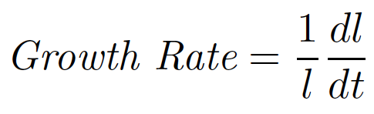
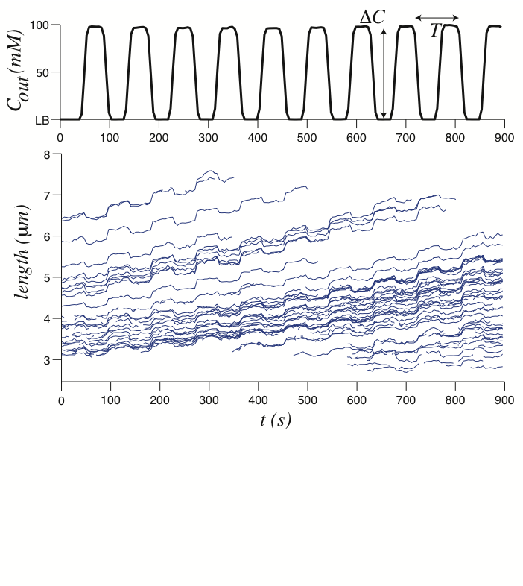
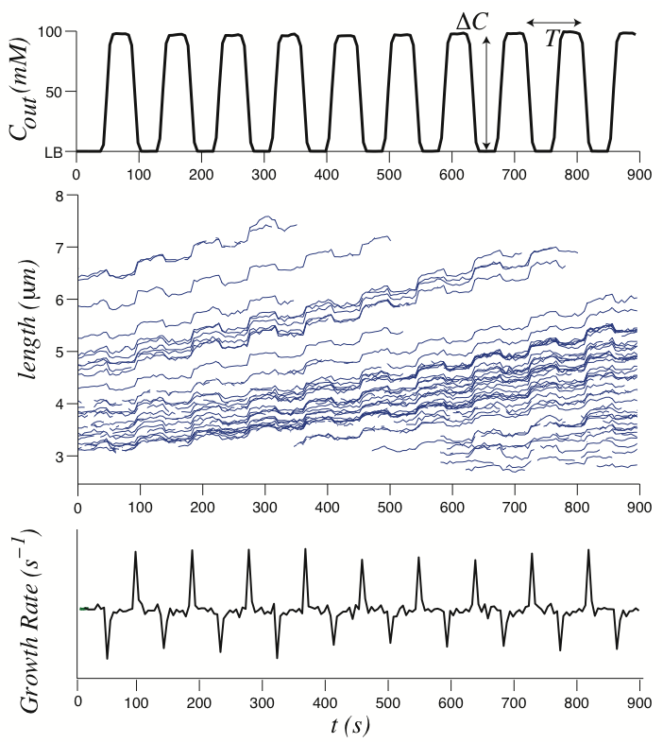
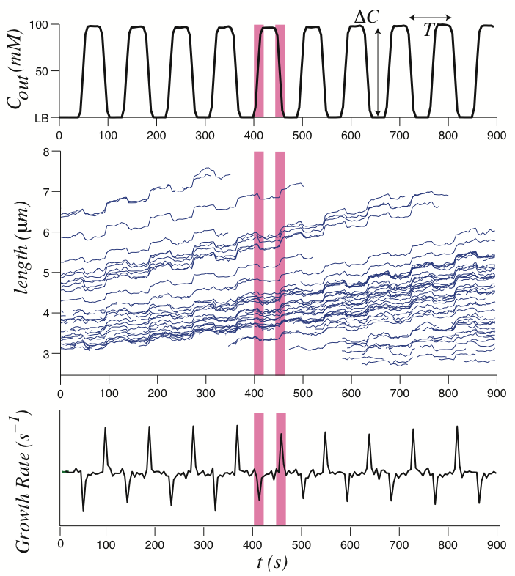
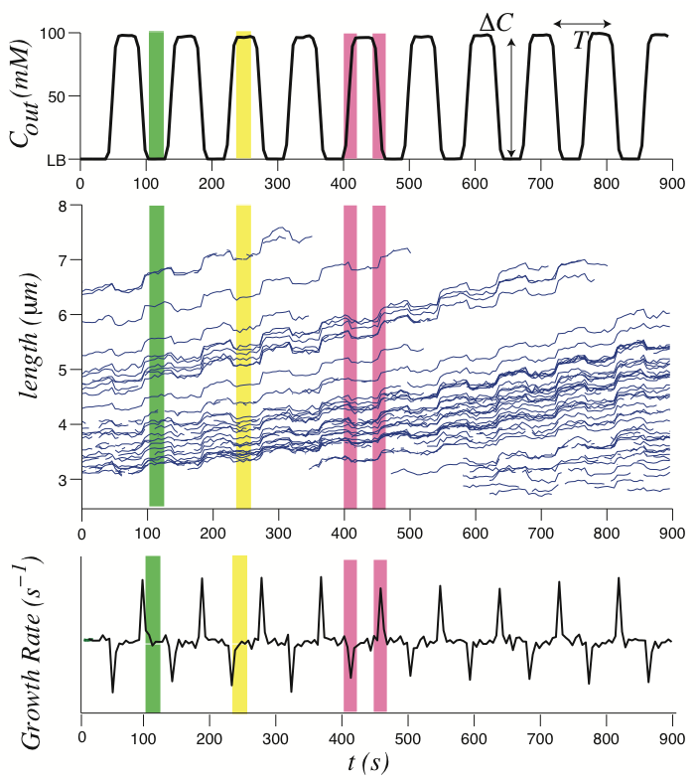
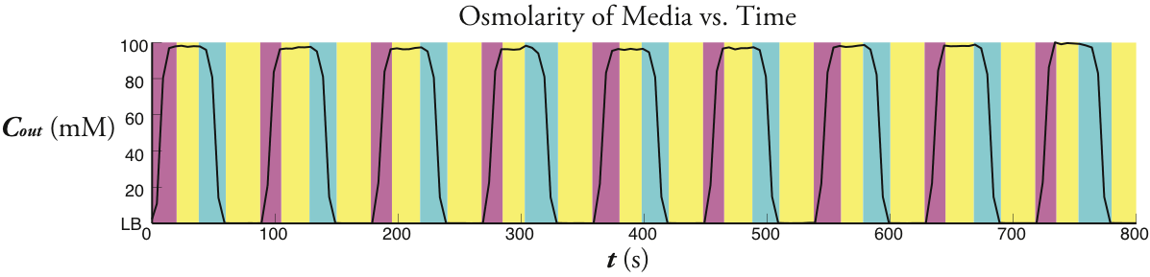

Measuring the response of E. coli to oscillatory osmotic shock
Notes:
Remember to say out loud that this is for e coli. also that you can modulate the period and amp.

Slide 6
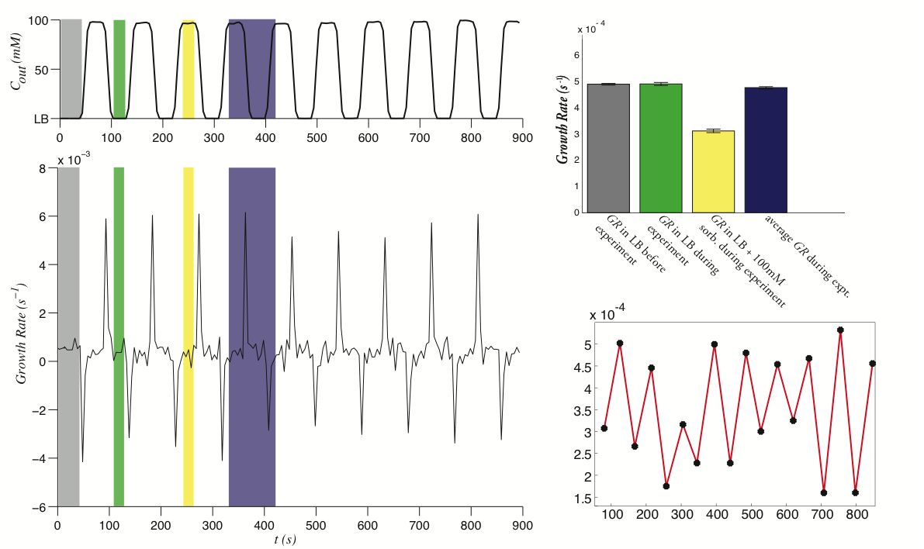
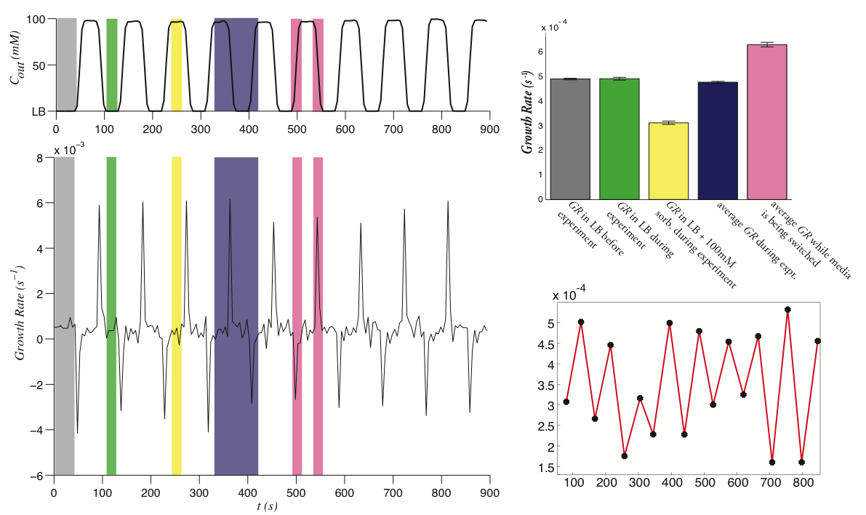
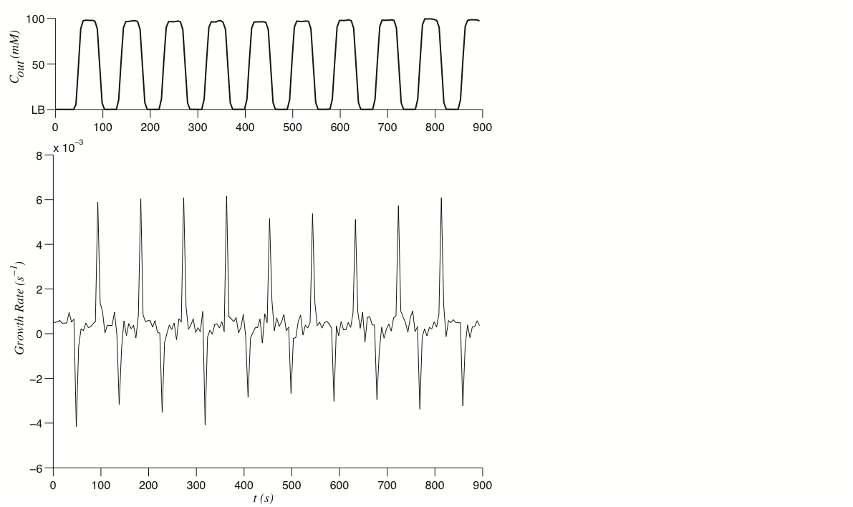
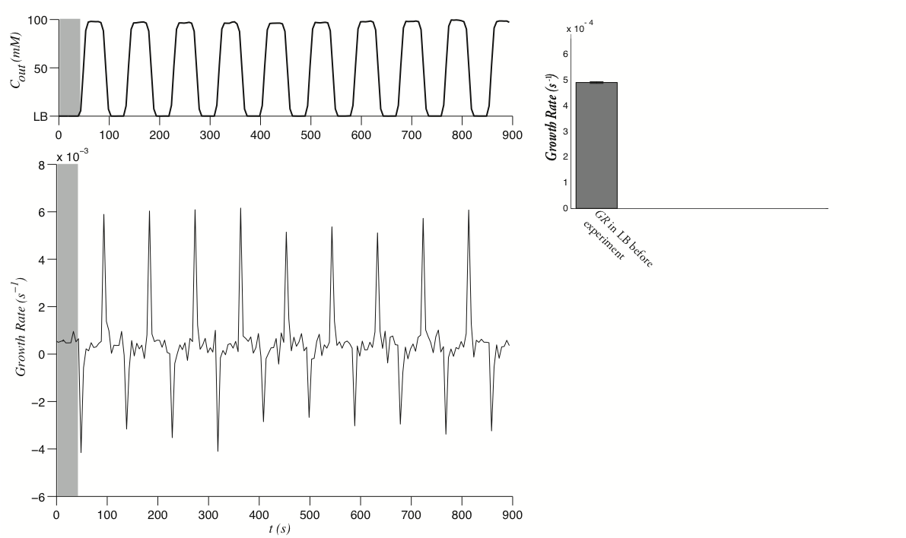
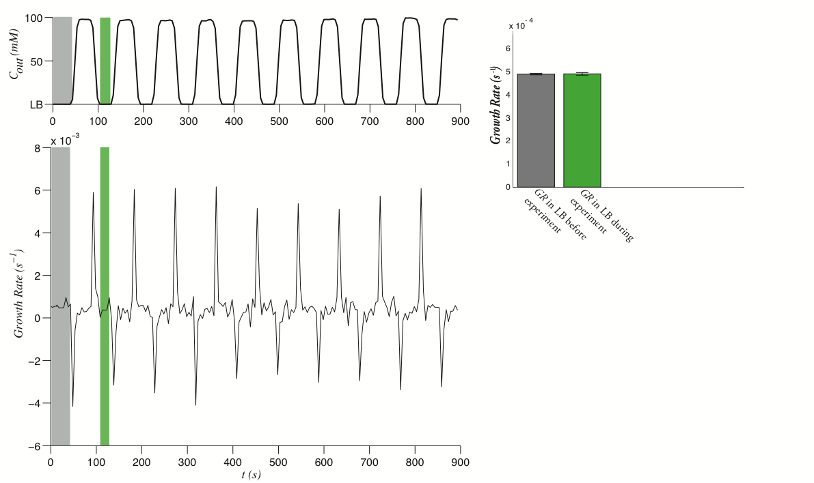
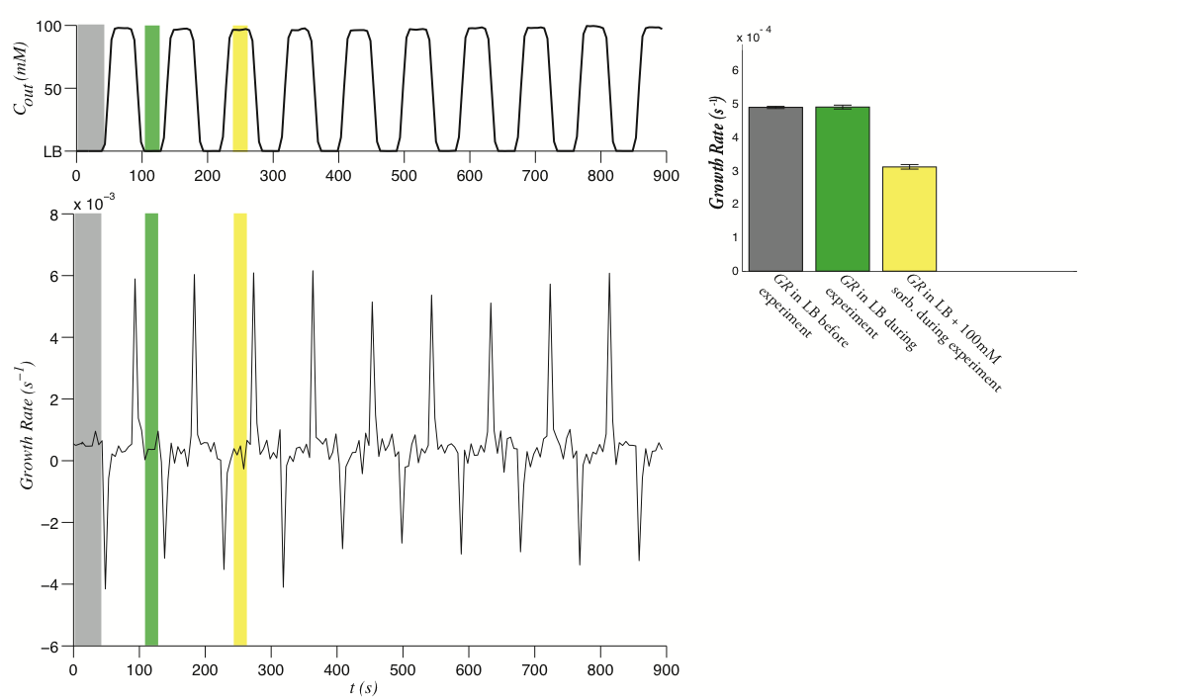
Dissecting this data reveals a simple mechanism of wall synthesis.
Notes:
remember to say that this is true over a wide range of frequencies and amplitudes

Slide 7
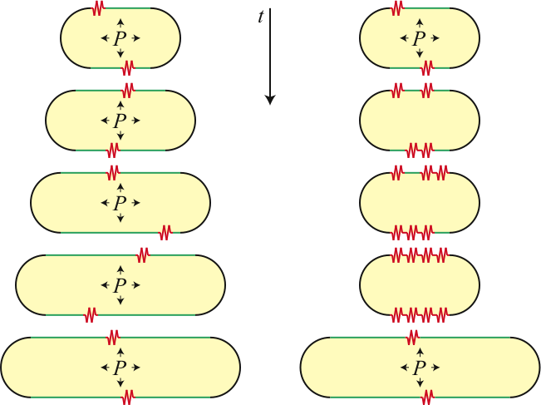
Model: in E. coli synthesis is rate limiting, but osmotic pressure is required.

Slide 8
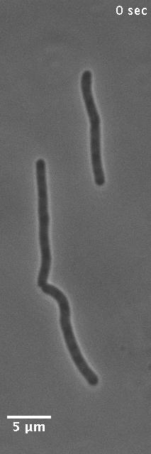
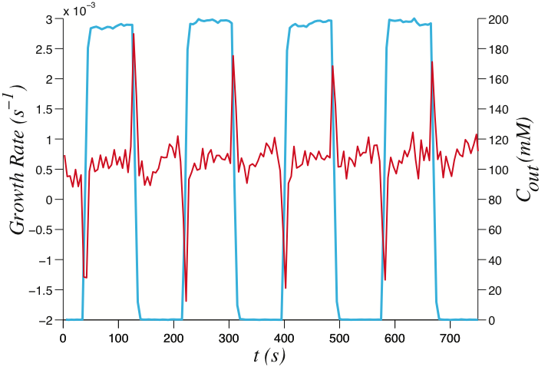
Bacillus subtilis exhibits a more drastic response to osmotic shock.

Slide 9
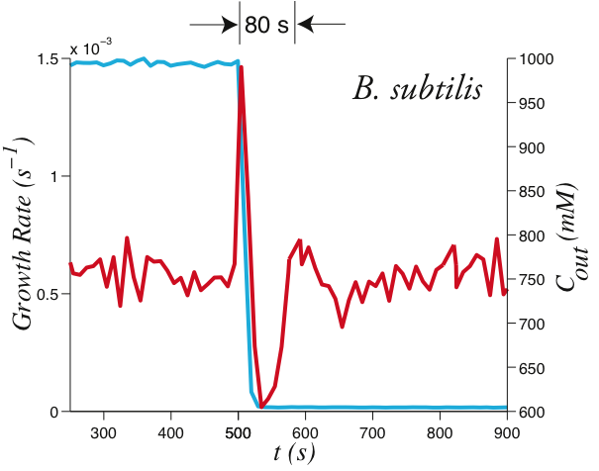
The growth rate of B. subtilis rings in response to downshock.

Slide 10
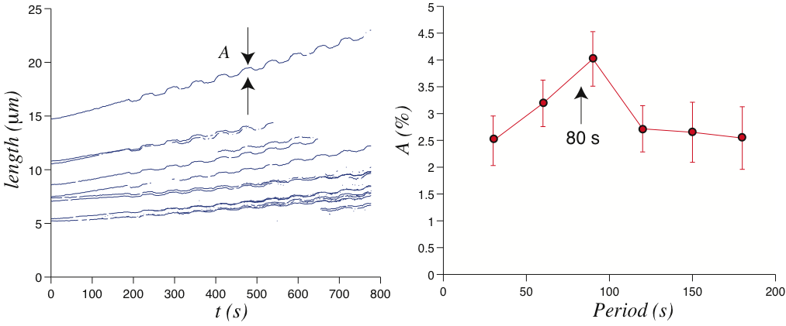
The existence of ringing predicts that we should be able to drive resonance.
Notes:
remind them that this is then an oscillatory expt.

Slide 11
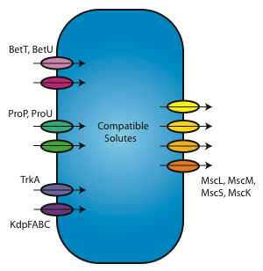
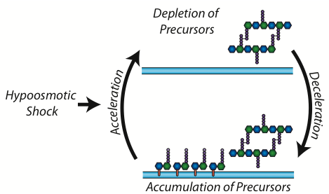
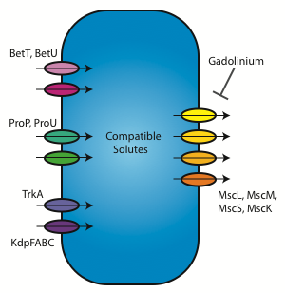
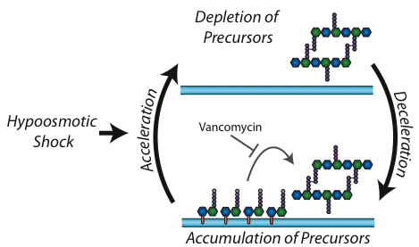
Potential Feedback Mechanisms
Pressure Model: osmotic shock triggers nonlinear feedback in osmoregulation.
Synthesis Model: osmotic shock results in an imbalance of wall precursors.

Slide 12
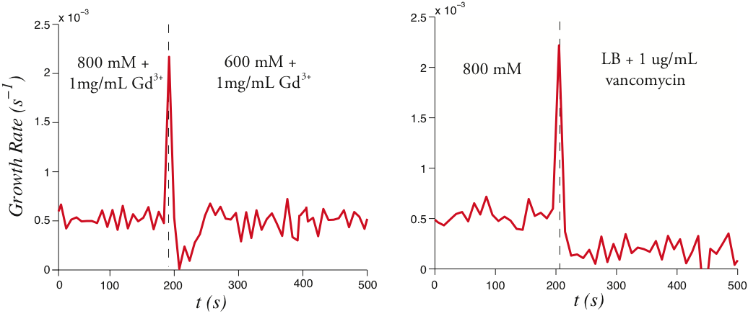
Ringing depends on the availability of wall precursors.

Slide 13
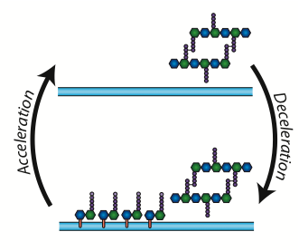
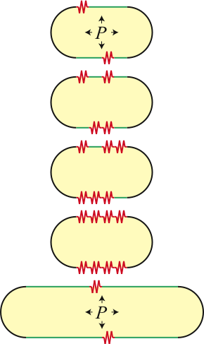
Conclusions/Working Models:
E. coli: Synthesis is rate limiting, but osmotic pressure is required for growth.
B. subtilis: Osmotic shock results in an imbalance of cell wall precursors.

Slide 14

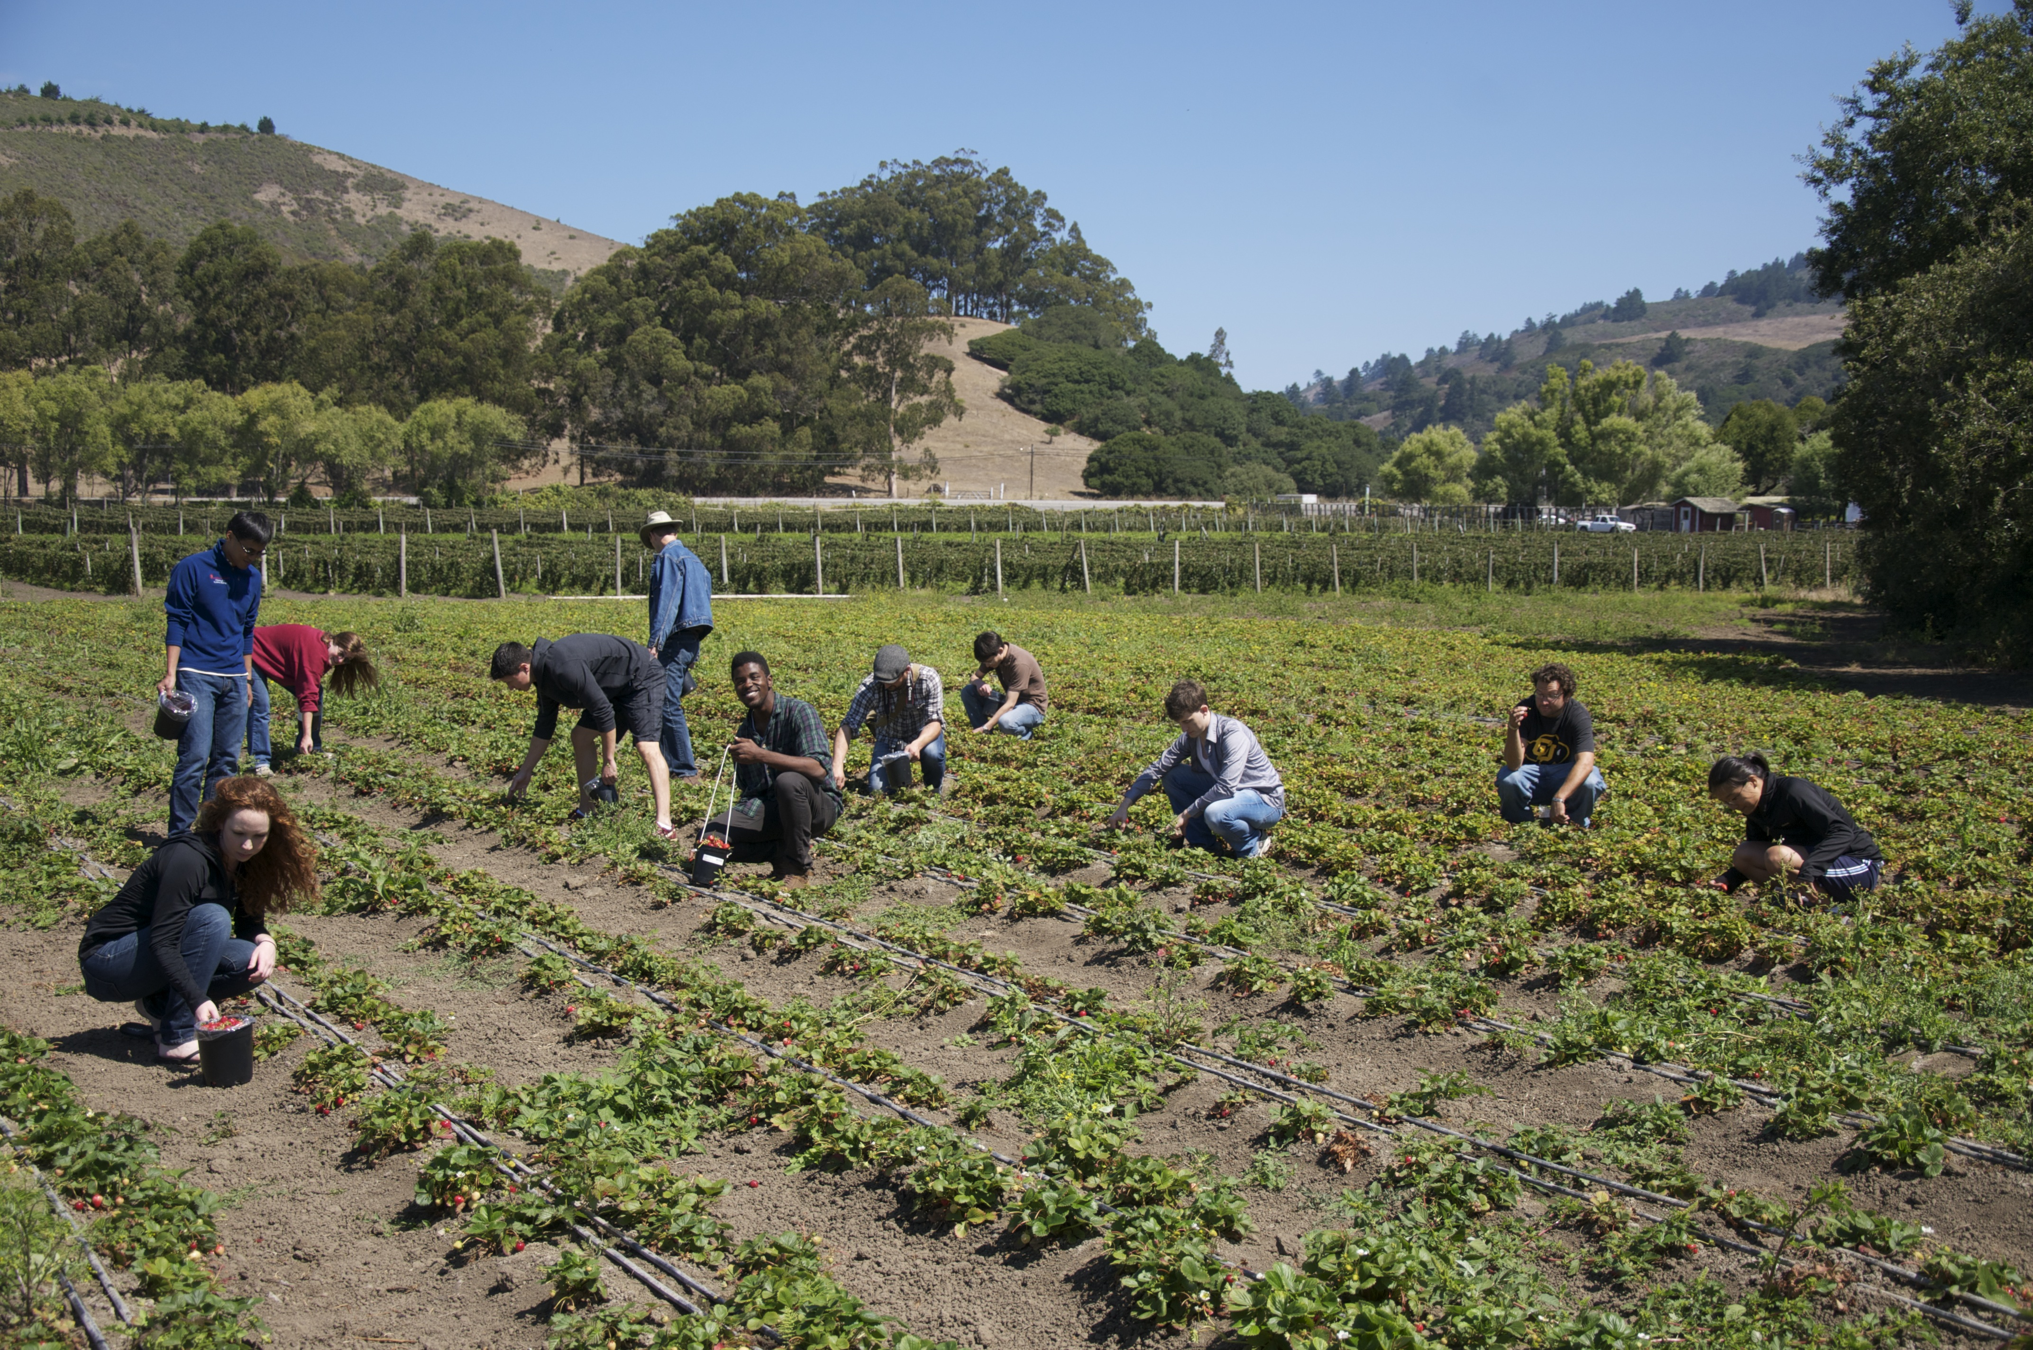

Thank You!

